Slide 1
HAZARD AND OPERABILITY STUDY (HAZOP)
UNIT-IV

Slide 2
What is HAZOP?
A hazard and operability study is a procedure for the systematic, critical, examination of the operability of a process
When applied to a process design or an operating plant, it indicates potential hazards that may arise from deviations from the intended design conditions

Slide 3
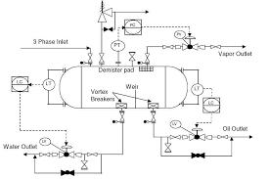
When to do?
Any stage of process cycle
If we have a basic and detailed engineering
If PID are complete
PID (Piping/process and Instrumentation Diagram

Slide 4
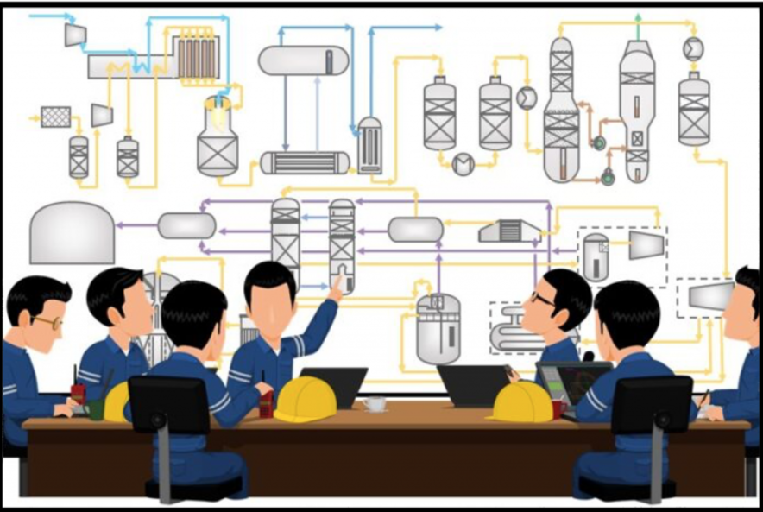
Pre-requisites
Detailed description of the process
PID diagram
Details about Alarms, trips (cause and effect diagram)

Slide 5
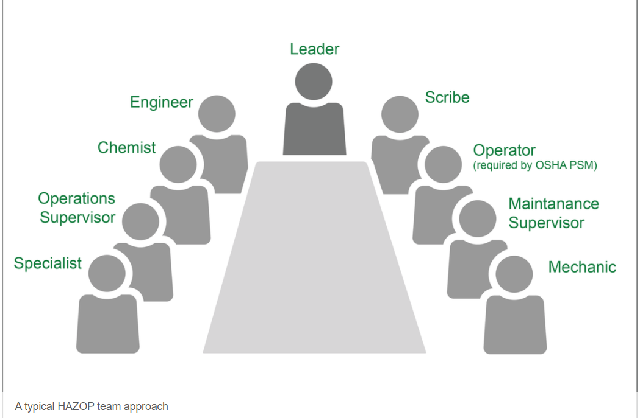
Hazop Team
Hazop Chairman
Scribe
Participants
Team members: 5-10

Slide 6
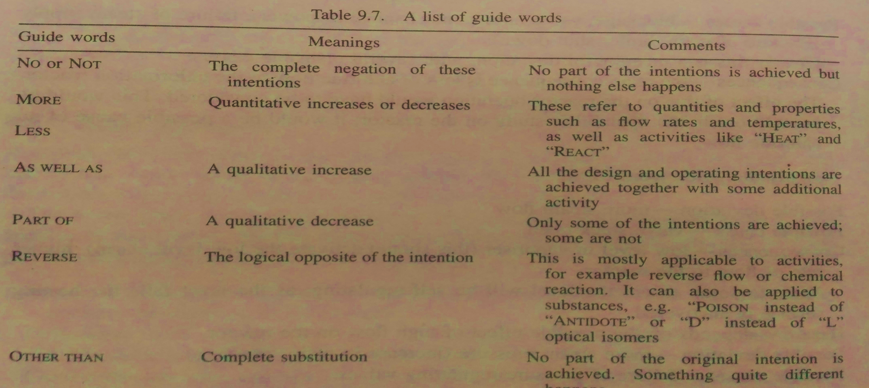
Basic principles
A formal operability study is the systematic study of the design, vessel by vessel and line by line using ‘ guide words’ to help generate thoughts about the way deviations from the intended operating conditions can cause hazardous situations
Seven guide words recommended in CIA (chemical industries association)

Slide 7
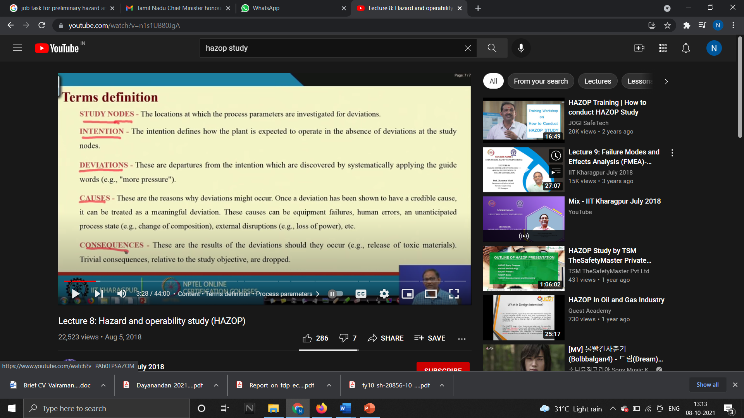
TERMS

Slide 8


Slide 9
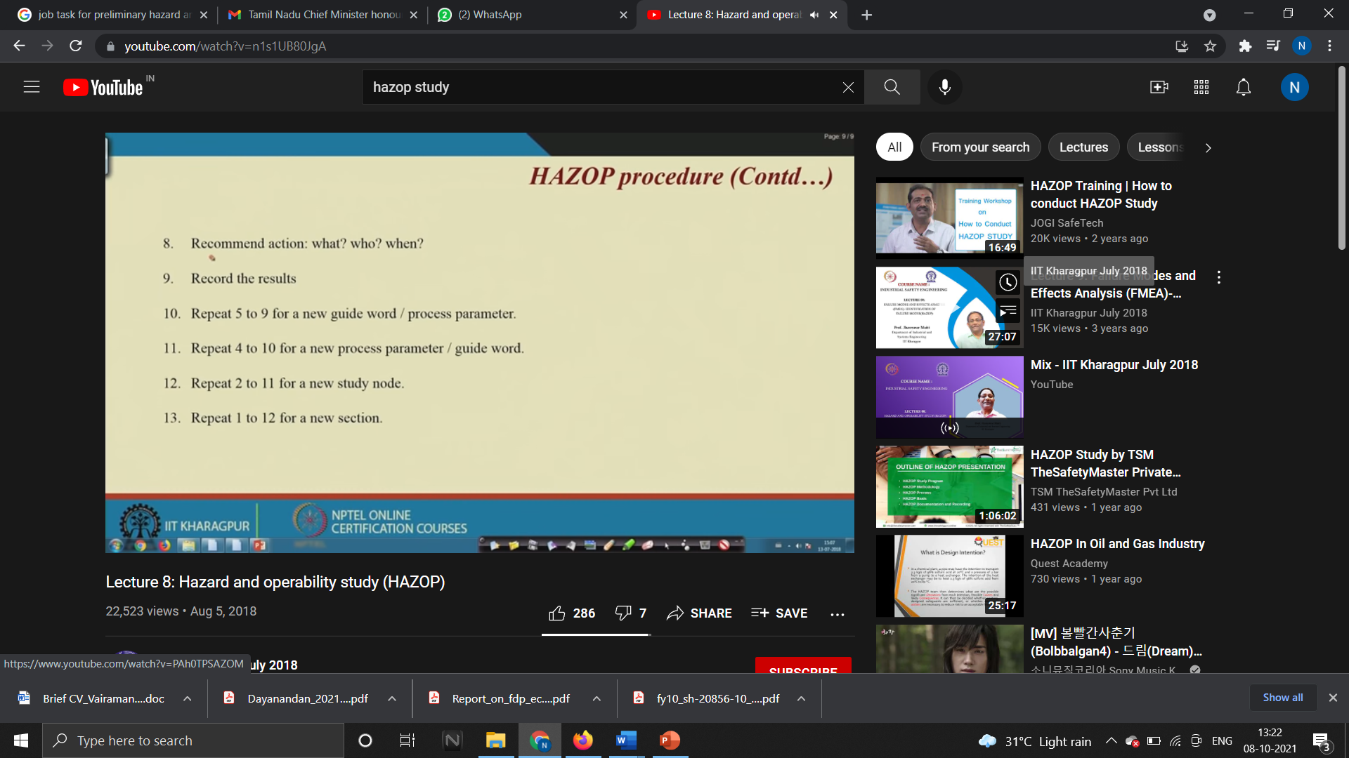

Slide 10


Slide 11
Conducting Hazop
Node – Identification
Individual PID into small nodes
If the design intention and process function changes, then a separate node should be identified
Identify the process deviation – nodewise
Guideword+process parameter
Combining, various deviations are noted

Slide 12
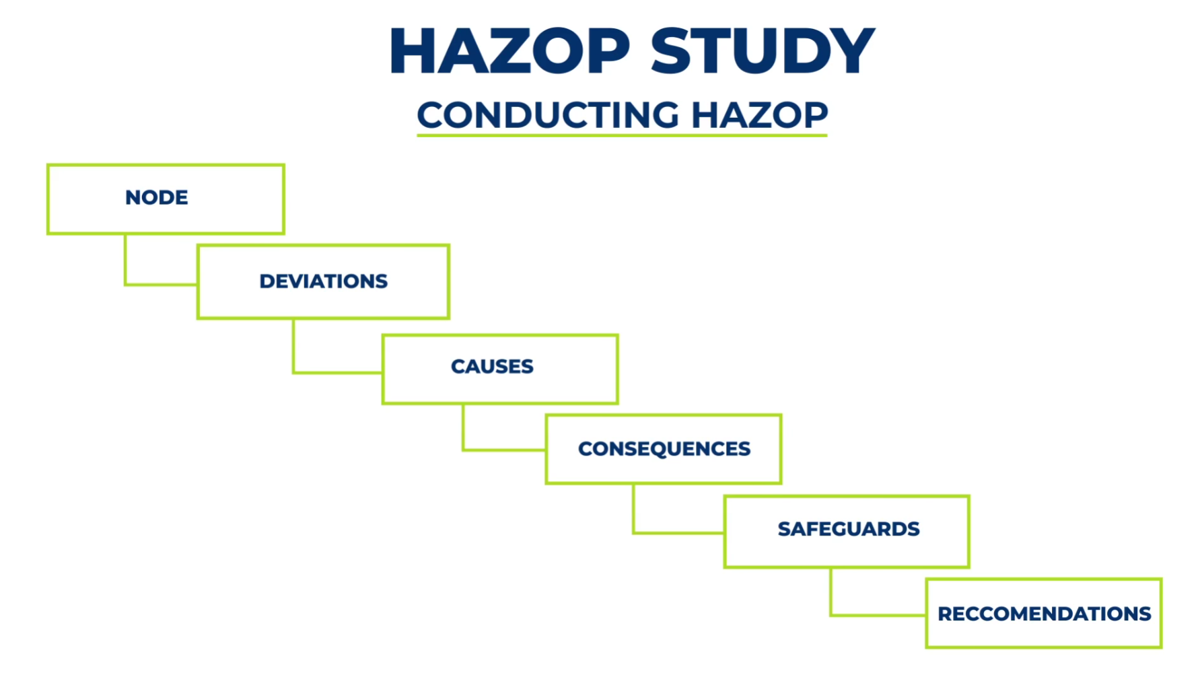
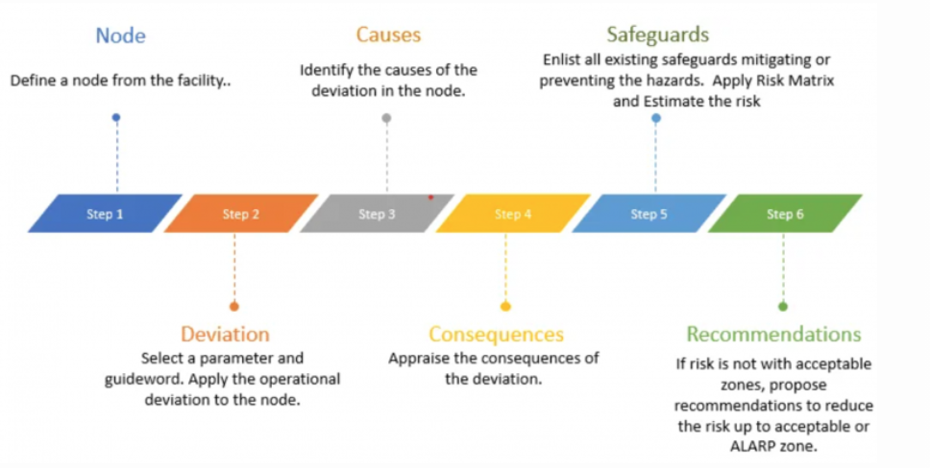

Slide 13
In addition to these words, the following words are also used in a special way
Guide words:
No or Not
More
Less
As Well As
Part of
Reverse
Other Than
Other Key items:
Intention – defines to the particular part of the process was intended to operate; intention of the designer
Deviations – these are departures from the designer’s intention which are detected by the systematic application of the guide words
Causes – reasons why and how the deviations occur. Only when the deviation can be shown to a realistic cause it is treated as meaningful
Consequences – the results that follow the occurrence of a meaningful deviation
Hazards – consequences that can cause damage or injury

Slide 14
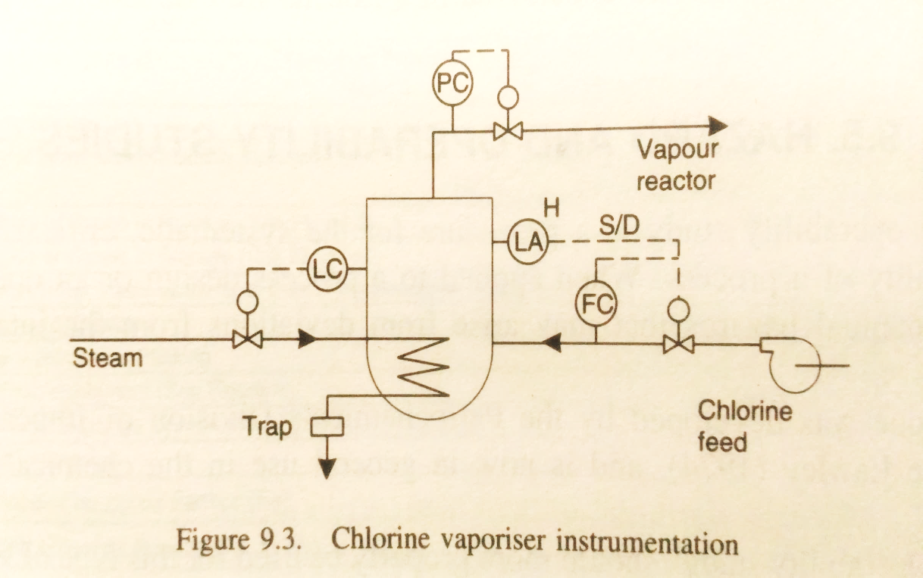
EXAMPLE 1: Chlorine vapouriser instrumentation
Consider steam supply line and associated control instrumentation
Steam shall be supplied at a pressure and flow rate to match the required chlorine demand
Guide Word MORE:
Possible Deviation – More steam flow
Possible causes – valve stuck open
Consequences – low level in vaporizer, higher rate of flow to reactor
Hazard – Depends on possible effect of high flow on the reactor
Possible Deviation – more steam pressure
Possible causes – failure of pressure regulating valves
Consequences – increased vaporization rate
Hazard – line rupture, effect of sudden increase in chlorine flow on reactor
Guide Word NO:
Possible Deviation – No steam flow
Possible causes – Blockage, valve failure, Failure of steam supply
Consequences – loss of chlorine flow to chlorination reactor

Slide 15
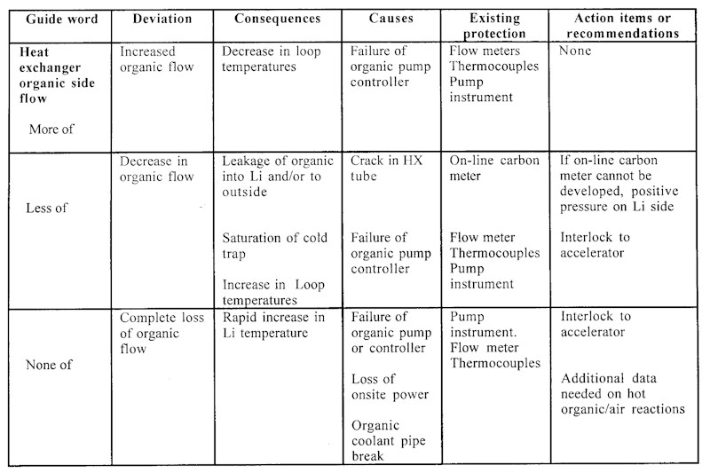
HAZOP FORM /WORKSHEET

